Slide 1
Application Controller Pattern
Jason Bullock
CIT360
Team E

Slide 2
Application Controller
Centralizes control, retrieval, and invocation of View and Command processing
responsible for identifying and invoking commands
identifying and dispatching to views
This pattern is a more complex version of MVC. As an application gets more complex you can unknowingly start duplicating code in separate controller class files. ACP lets you reuse code that performs the same function, but in different ways

Slide 3
Application Controller (continued)
For example, an wizard driven program that asks a user to enter information screen by screen. The user is directed to each screen in a specific order. Each screen has a separate View class, perhaps a different Model as well. But if the screens are doing similar things, you should create a single Controller class.
A developer can reuse code by placing all flow logic in an application controller class and then ask it for the correct commands to execute against the appropriate model and correct view.
In a more technical explanation, this pattern “allows you to reuse any chunks of the presentation logic that is not directly bound to the technicalities of a given platform.” (http://dotnetslackers.com/articles/designpatterns/The-Presenter-in-MVP-Implementations.aspx

Slide 4
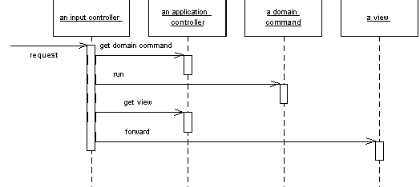
UML sequence diagram sample of Application Controller Pattern

Slide 5
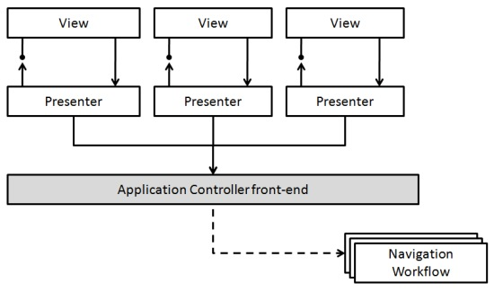
Benefits of using Application Controller Pattern
Improves extensibility
Improves separation of concerns
Allows for reuse of code – less is more

Slide 6
Code Sample
Apply common control logic
Have centralized view management

